Slide 1
Microsoft Movie Analysis

Slide 2
Content
Business Problem
The Data
The Method
The Results
Conclusion

Slide 3
Business Problem
Microsoft wants to join the fun as they see so many large firms producing original video content. hey've chosen to start a new movie company, but they have no experience making movies. You are expected to research the genres of movies that are currently performing the best at the box office. The next step is to translate your research into practical insights that the head of Microsoft's new film division can use to guide the production of particular films.

Slide 4
Questions to be answered
1 . Release timings that contribute to a movie success.
2 . Month with the most movies released.
3 . Average revenue per month
4 . Genres with the most number of movies produced.
5 . Genres that contribute to a movie success
6 . Directors that contribute to a movie success
7 .Which are the top studios we would be competing against?
8 . Release month with the highest net profitpotentially
9 . Which are the top studios we would potentially be competing against?
10 . Studio with most movies
11 . Top studio in terms of worldwide gross revenue
12 .Movies with the highest Profit
13. Relationship between production_budget,worldwide_gross and Net_profit

Slide 5
Data Used in the Analysis
Below are the datasets used in the analysis
bom.movie_gross.csv.gz' imdb.name.basics.csv.gz' imdb.title.akas.csv.gz' imdb.title.basics.csv.gz' imdb.title.crew.csv.gz' imdb.title.principals.csv.gz' imdb.title.ratings.csv.gz' rt.movie_info.tsv.gz' rt.reviews.tsv.gz' tmdb.movies.csv.gz' tn.movie_budgets.csv.gz'

Slide 6
Method used in the analysis
Data cleaning
Descriptive Statistics
Visualization.

Slide 7
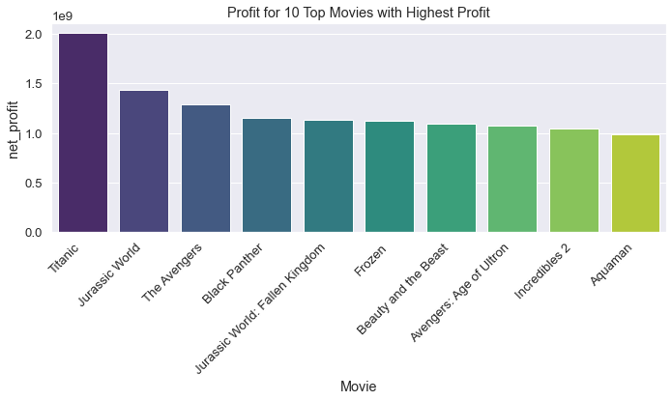
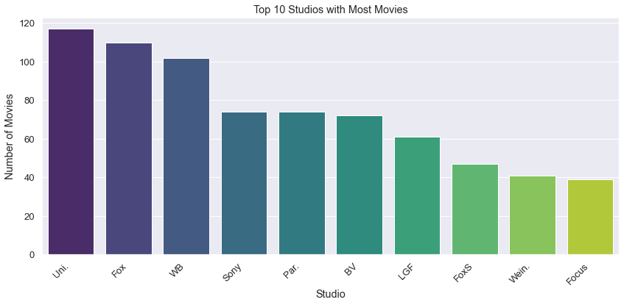
Movies with the highest Profit
Studio with most movies
Universal, Fox, and WB are the top three studios with over 100 movies each. Based on the amount of movies made, they could be potential competitors.
Titanic movies made the highest net profit

Slide 8
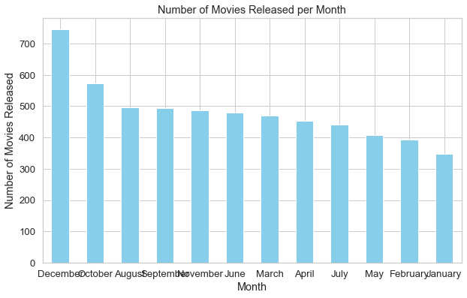
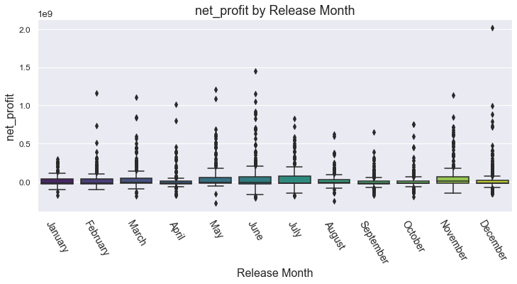
Based on net_profit per release month , June, November, and may seemed to be the most profitable months with the highest net_profit value for world box office net_profit
Month with the most movies released.
Release month with the highest net profit

Slide 9
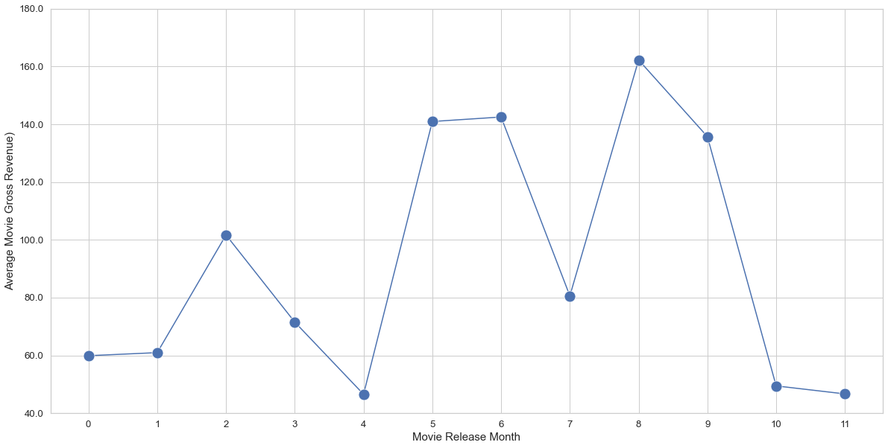
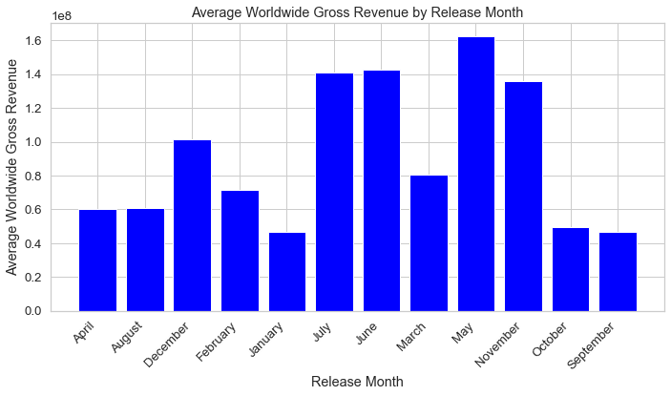
Average revenue per month
From the two charts above, movies released in May, July June and November had the highest average gross revenue compared to the othe months

Slide 10
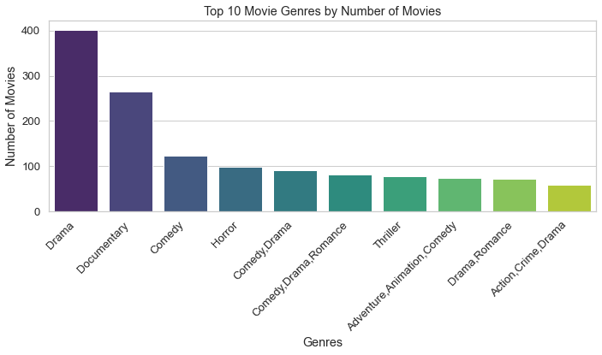
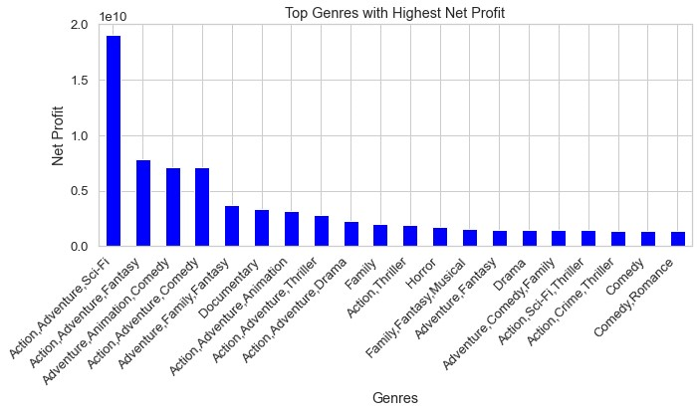
Drama is the most popular genre by far with a total of 402 movies.
Genres with the most number of movies produced.
Genres that contribute to a movie success
Drama is the most popular genre by far with a total of 402 movies, based on the tow bar chats the most popular genre isn't necessarily the most successful. Looking at the highest average net profit per genre, Action,Adventure,Sci-Fi wins with the highest net profit. My recommendation would be to choose genres based on net profit and not popularity.

Slide 11
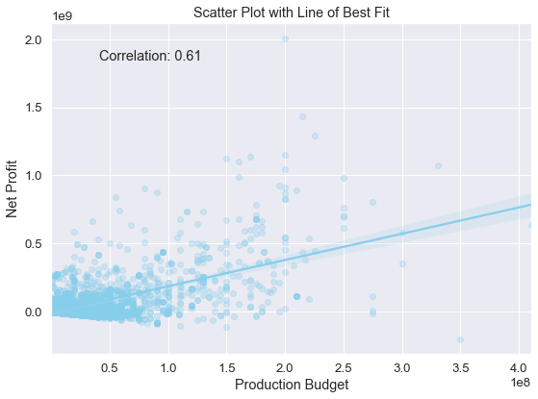
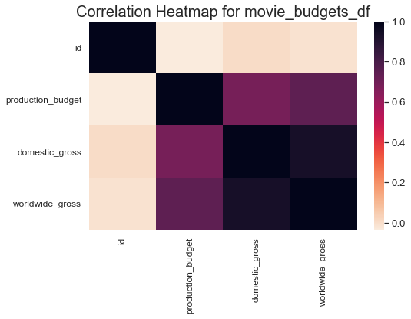
Relationship between production_budget,worldwide_gross and Net_profit
The regression line in this plot shows the general increase in movie Net Profit as the budget increases. This plot confirmed my hypothesis that a higher production budget typically leads to a higher box office profit.
This means that there is a tendency for movies with higher production budgets to achieve higher net profits, and movies with lower production budgets may have relatively lower net profits

Slide 12
Conclusion
I will recommend Microsoft to be release movies in May, June and November since that’s when most movies studio make the most net proft and gross revenue.
Microsoft to be releasing Action,Adventure,Sci-Fi and Drama movies since they have high viewership and profit.
Universal, Fox, and WB are the top three studios with over 100 movies each. Based on the amount of movies made, they could be potential competitors

